Slide 1
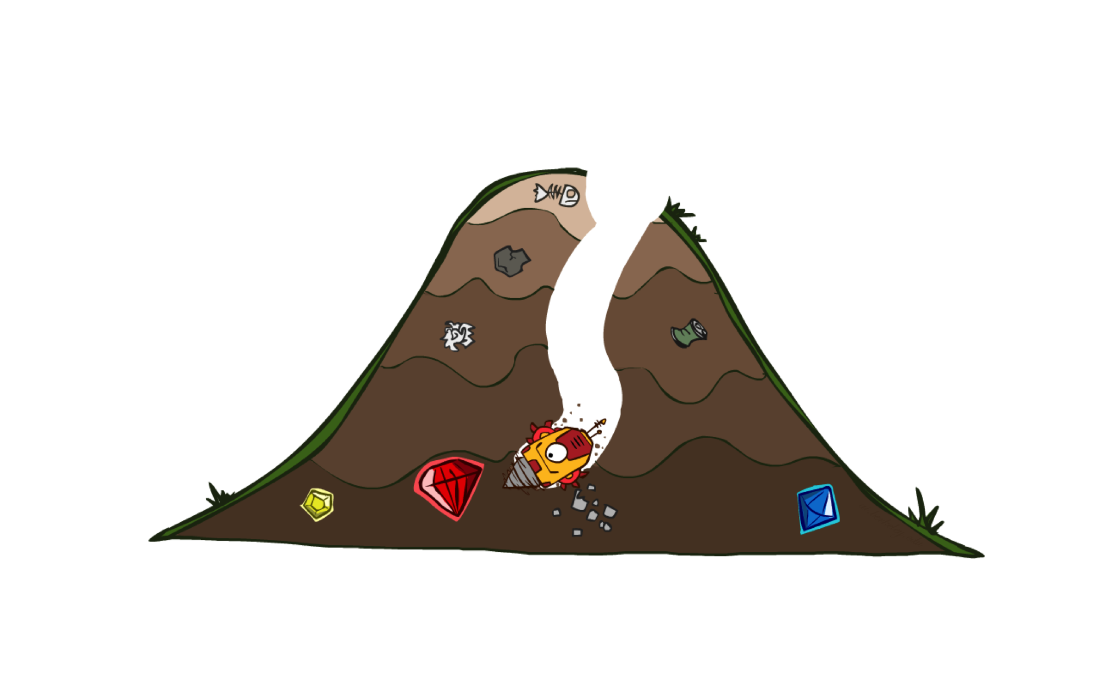
Informed Search - II
A* Search Algorithm

Slide 2
Previous Lecture
Heuristics
Greedy Search

Slide 3
A* Search
eval-fn: $f(n)=g(n)+h(n)$

Slide 4
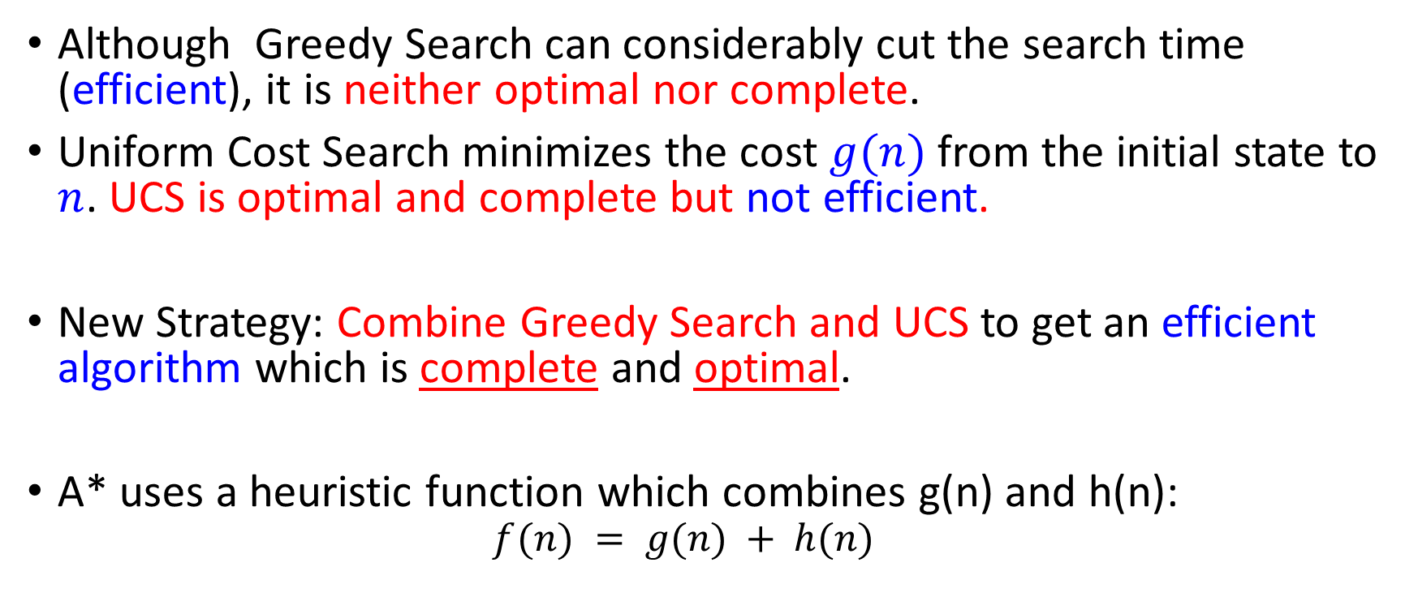
A* (A Star)
Although Greedy Search can considerably cut the search time (efficient), it is neither optimal nor complete.
Uniform Cost Search minimizes the cost $g(n)$ from the initial state to $n$. UCS is optimal and complete but not efficient.
New Strategy: Combine Greedy Search and UCS to get an efficient algorithm which is complete and optimal.
A* uses a heuristic function which combines g(n) and h(n):
  $$f(n) = g(n) + h(n)$$

Slide 5
Combining UCS and Greedy
Uniform-cost orders by path cost, or backward cost g(n)
Greedy orders by goal proximity, or forward cost h(n)
A* Search orders by the sum: f(n) = g(n) + h(n)
8
g = 0 h=6
S
e
h=1
g = 1 h=5
a
1
1
3
2
g = 2 h=6
g = 9 h=1
S
a
d
G
b
d
g = 4 h=2
e
h=6
1
h=5
h=2
h=0
1
g = 3 h=7
g = 6 h=0
g = 10 h=2
c
b
c
G
d
h=7
h=6
g = 12 h=0
G

Slide 6

A* Search
Start
State | Heuristic: h(n)
A | 366
B | 374
C | 329
D | 244
E | 253
F | 178
G | 193
H | 98
I | 0
A
75
118
140
B
C
111
E
D
80
99
G
F
97
H
211
101
I
Goal
f(n) = g(n) + h (n)
g(n): is the exact cost to reach node n from the initial state.

Slide 7
A* Search: Tree Search
A
Start

Slide 8
A* Search: Tree Search
A
Start
118
75
140
E
[140+253=393]
B
[75+374=449]
[118+329=447]
C

Slide 9
A* Search: Tree Search
A
Start
118
75
140
E
[140+253=393]
B
[75+374=449]
[118+329=447]
C
80
99
G
F
[239+178=417]
[220+193=413]

Slide 10
A* Search: Tree Search
A
Start
118
75
140
E
[140+253=393]
B
[75+374=449]
[118+329=447]
C
80
99
G
F
[239+178=417]
[220+193=413]
97
[317+98=415]
H

Slide 11

A* Search: Tree Search
A
Start
118
75
140
E
[140+253=393]
B
[75+374=449]
[118+329=447]
C
80
99
G
F
[239+178=417]
[220+193=413]
97
[317+98=415]
H
101
I
[418+0=418]
Goal

Slide 12

A* Search: Tree Search
A
Start
118
75
140
E
[140+253=393]
B
[75+374=449]
[118+329=447]
C
80
99
G
F
[239+178=417]
[220+193=413]
97
211
[317+98=415]
H
I
[450+0=450]
101
I
[418+0=418]
Goal

Slide 13
A* Search: Tree Search
A
Start
118
75
140
E
[140+253=393]
B
[75+374=449]
[118+329=447]
C
80
99
G
F
[239+178=417]
[220+193=413]
97
211
[317+98=415]
H
I
[450+0=450]
101
I
[418+0=418]
Goal

Slide 14
A* Search: Tree Search
A
Start
118
75
140
E
[140+253=393]
B
[75+374=449]
[118+329=447]
C
80
99
G
F
[239+178=417]
[220+193=413]
97
211
[317+98=415]
H
I
[450+0=450]
101
I
[418+0=418]
Goal
dist(A-E-G-H-I) =140+80+97+101=418

Slide 15

A* search example

Slide 16
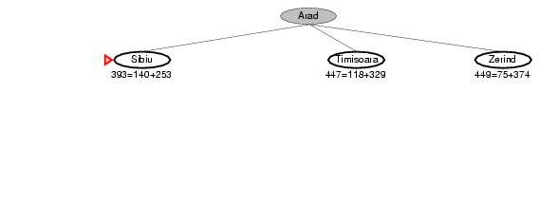
A* search example

Slide 17
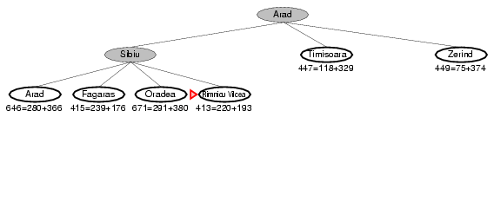
A* search example

Slide 18
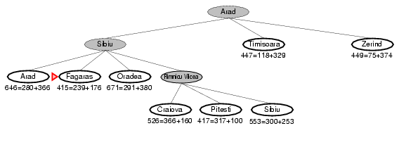
A* search example

Slide 19
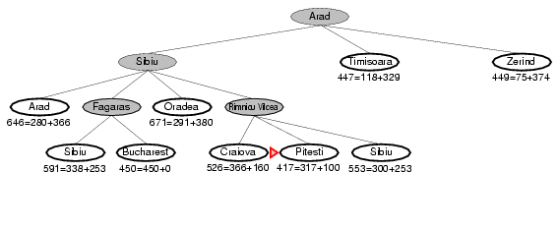
A* search example

Slide 20
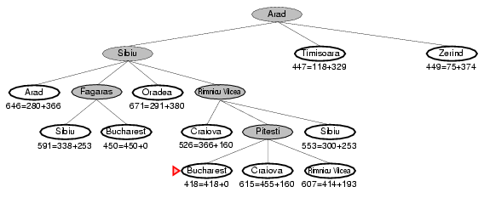
A* search example

Slide 21

Heuristic Value
S | 7
A | 6
B | 2
C | 1
D | 0
 | FRONTIER | EXPAND | EXPLORED
1 | (S,0+7=7) | S | Empty
2 | (S-A,1+6=7)(S-B,4+2=6) | B | S
3 | (S-A,7)(S-B-C,6+1=7) | A | S,B
4 | (S-A-B,3+2=5)(S-A-C,6+1=7)(S-A-D,13+0=13)(S-B-C,7) | C | S,B,A
5 | (S-A-C-D,9+0=9) )(S-A-D,13+0=13) | D | S,B,A,C
6 | OR (S-B-C-D,9+0=9) )(S-A-D,13+0=13)
7
S
1
4
2
A
B
5
12
2
C
D
3
f(n) = g(n)+h(n)

Slide 22
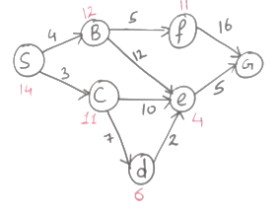

Slide 23
Is A* Optimal?
h = 6
1
A
3
S
h = 7
G
h = 0
5
What went wrong?
  Actual bad goal cost < estimated good goal cost
  We need estimates to be less than actual costs!

Slide 24
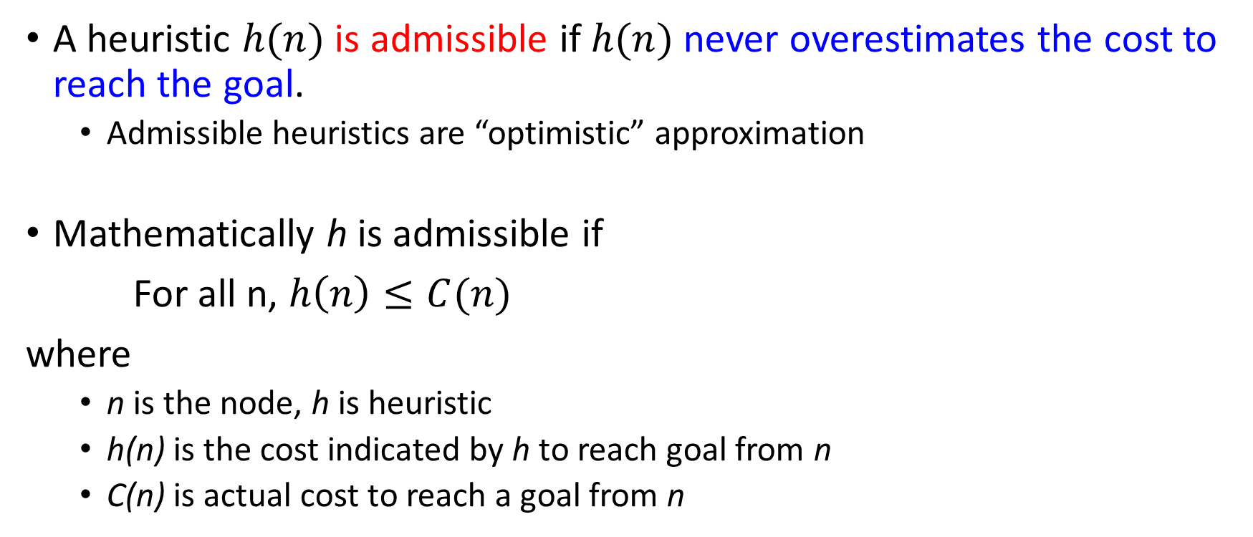
Admissible Heuristic Functions
A heuristic $h(n)$ is admissible if $h(n)$ never overestimates the cost to reach the goal.
  Admissible heuristics are “optimistic” approximation
Mathematically h is admissible if
For all n, $h\left(n\right)≤C(n)$
where
  n is the node, h is heuristic
  h(n) is the cost indicated by h to reach goal from n
  C(n) is actual cost to reach a goal from n

Slide 25
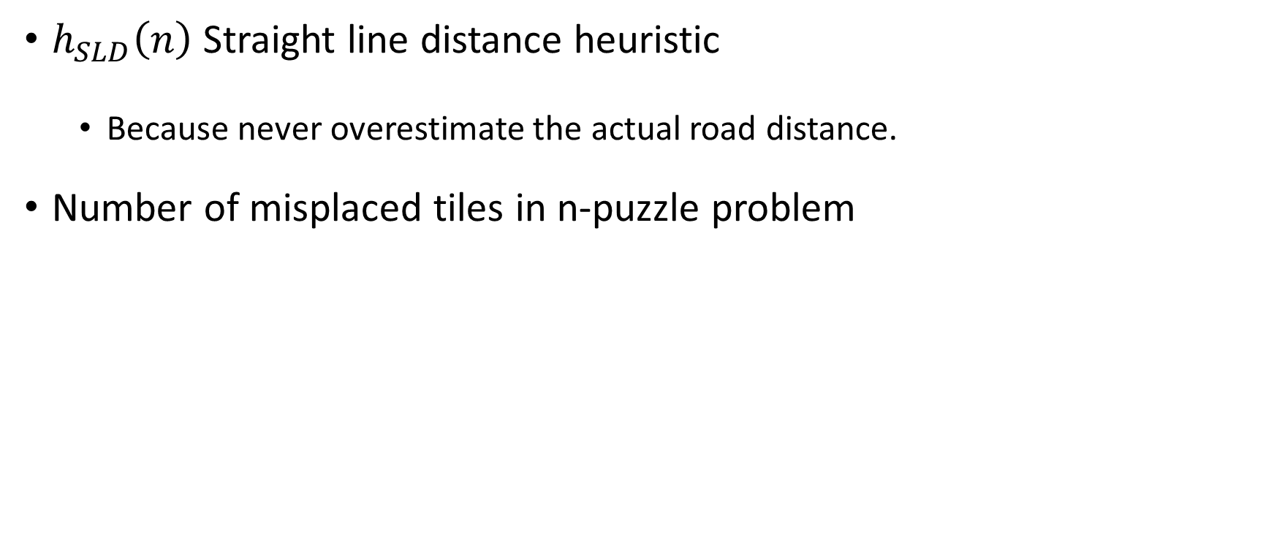
Admissible heuristics Examples
$h_{SLD}\left(n\right)$ Straight line distance heuristic
  Because never overestimate the actual road distance.
Number of misplaced tiles in n-puzzle problem

Slide 26
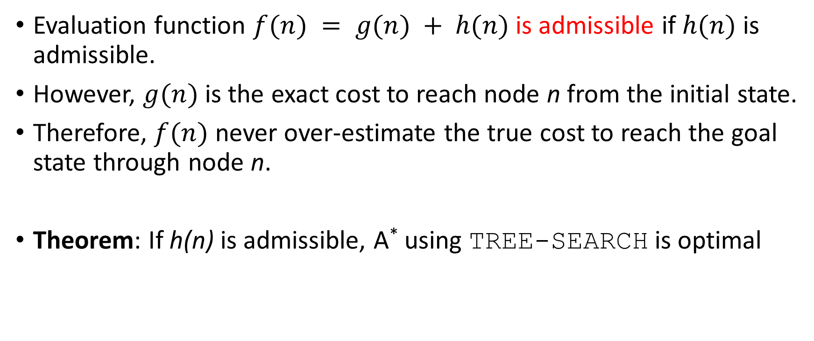
Admissible Heuristic Functions
Evaluation function $f(n) = g(n) + h(n)$ is admissible if $h(n)$ is admissible.
However, $g(n)$ is the exact cost to reach node n from the initial state.
Therefore, $f(n)$ never over-estimate the true cost to reach the goal state through node n.
Theorem: If h(n) is admissible, A* using TREE-SEARCH is optimal

Slide 27

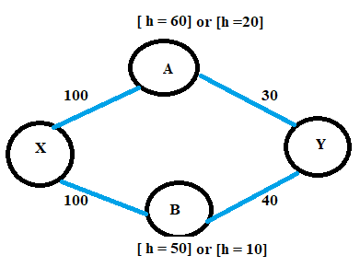








Example
h=80
h∗(n) = Actual cost of the optimal path from node n to the goal node
Notes:
You cannot check admissibility by comparing h(X) to the full path cost alone.
You must check each heuristic value like this:
h(X)≤cost from X to goal
h(B)≤cost from B to goal
Here
h(X)=80<=100+40 admissible
h(X)=80<=100+30 admissible
h(A) = 60 > 30 not admissible
h(B) = 50 > 40 not admissible
If a single one fails we will say that admissibility failed

Slide 28
A* Search: if h not admissible
State | Heuristic: h(n)
A | 366
B | 374
C | 329
D | 244
E | 253
F | 178
G | 193
H | 138
I | 0
Start
A
75
118
140
B
C
111
E
D
80
99
G
F
97
H
211
101
I
f(n) = g(n) + h (n) – (H-I) Overestimated
g(n): is the exact cost to reach node n from the initial state.
Goal

Slide 29
A* Search: Tree Search
A
Start

Slide 30
A* Search: Tree Search
A
Start
118
75
140
E
[393]
B
[449]
[447]
C

Slide 31
A* Search: Tree Search
A
Start
118
75
140
E
[393]
B
[449]
[447]
C
80
99
[413]
G
F
[417]

Slide 32
A* Search: Tree Search
A
Start
118
75
140
E
[393]
B
[449]
[447]
C
80
99
[413]
G
F
[417]
97
[455]
H

Slide 33
A* Search: Tree Search
A
Start
118
75
140
E
[393]
B
[449]
[447]
C
80
99
[413]
G
F
[417]
97
211
[455]
I
H
Goal
[450]

Slide 34
A* Search: Tree Search
A
Start
118
75
140
E
[393]
B
[449]
[447]
C
80
99
[473]
[413]
G
F
[417]
D
97
211
[455]
I
H
Goal
[450]

Slide 35
A* Search: Tree Search
A
Start
118
75
140
E
[393]
B
[449]
[447]
C
80
99
[473]
[413]
G
F
[417]
D
97
211
[455]
I
H
Goal
[450]

Slide 36
A* Search: Tree Search
A
Start
118
75
140
E
[393]
B
[449]
[447]
C
80
99
[473]
[413]
G
F
[417]
D
97
211
[455]
I
H
Goal
[450]

Slide 37
A* Search: Tree Search
A
Start
118
75
140
E
[393]
B
[449]
[447]
C
80
99
[473]
[413]
G
F
[417]
D
97
211
[455]
I
H
Goal
[450]
A* not optimal !!!
When heuristic h is not admissible
dist(A-E-F-I) =140+99+211=450

Slide 38
A* Tree Search
State space graph
Search tree
h=4
S (0+2)
1
A
1
h=1
S
C
A (1+4)
C (3+1)
h=2
3
3
C (2+1)
G (6+0)
G (5+0)
G
h=0

Slide 39
Consistency of Heuristics
A
1
Main idea: Estimated heuristic costs ≤ actual costs
  Admissibility:
  heuristic cost ≤ actual cost to goal
  h(A) ≤ actual cost from A to G
  Consistency:
  “heuristic step cost” ≤ actual cost for each step
  h(A) – h(C) ≤ cost(A to C)
  triangle inequality
  h(A) ≤ cost(A to C) + h(C)
Consequences of consistency:
  The f value along a path never decreases
  A* graph search is optimal
C
h=4
h=2
h=1
G
But an admissible heuristic is not always consistent
Notes:
Both of these are linked
Admissibility is about the destination:
"Don't overestimate the cost to the goal."
Consistency is about the journey:
"Every step along the path should not make the heuristic jump up in value."

Slide 40
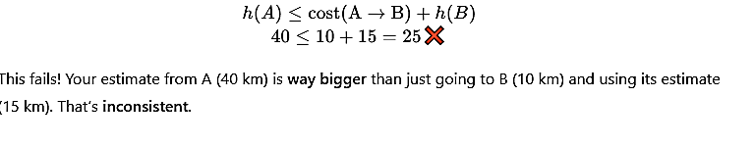





Consistency of Heuristics
Imagine you’re traveling between cities. Here’s the map:
City A --(10 km)--> City B --(20 km)--> City C (Goal)
If we take heuristic as:
h(C) = 0 (You're at the goal, so no cost)
h(B) = 15 (You estimate B is 15 km away from the goal)
h(A) = 40 (You estimate A is 40 km away from the goal)
Now apply the consistency rule:
A heuristic is consistent
But an admissible heuristic is not always consistent
Notes:
With an inconsistent heuristic, you might reach the same node again later via a cheaper path — and A* has to revisit and reprocess it, which breaks efficiency and complicates the algorithm.

Slide 41

Consistency of Heuristics
Imagine your GPS app gives you driving time estimates.
You’re at City A, and it says “You’re 30 mins away from City C”.
If you drive to City B (10 mins), and it says “You’re now 20 mins away”, that makes sense.
But if it said “You’re 30 mins away” after getting closer — something’s clearly off!
That’s like an inconsistent heuristic — it doesn’t improve as you get closer.

Slide 42
A* Algorithm
1. Search queue Q is empty.
2. Place the start state s in Q with f value h(s).
3. If Q is empty, return failure.
4. Take node n from Q with lowest f value.
(Keep Q sorted by f values and pick the first element).
5. If n is a goal node, stop and return solution.
6. Generate successors of node n.
7. For each successor n’ of n do:
    a) Compute f(n’) = g(n) + h(n’).
    b) If n’ is new (never generated before), add n’ to Q.
    c) If node n’ is already in Q with a higher f value, replace it with current f(n’) and place it in sorted order in Q.
    End for
8. Go back to step 3.

Slide 43
function UNIFORM-COST-SEARCH(problem) returns a solution, or failure
initialize the explored set to be empty
initialize the frontier as a priority queue using g(n) as the priority
add initial state of problem to frontier with priority g(S) = 0
loop do
if the frontier is empty then
return failure
choose a node and remove it from the frontier
if the node contains a goal state then
return the corresponding solution
add the node state to the explored set
for each resulting child from node
if the child state is not already in the frontier or explored set then
add child to the frontier
else if the child is already in the frontier with higher g(n) then
replace that frontier node with child

Slide 44
function A-STAR-SEARCH(problem) returns a solution, or failure
initialize the explored set to be empty
initialize the frontier as a priority queue using f(n) = g(n) + h(n) as the priority
add initial state of problem to frontier with priority f(S) = 0 + h(S)
loop do
if the frontier is empty then
return failure
choose a node and remove it from the frontier
if the node contains a goal state then
return the corresponding solution
add the node state to the explored set
for each resulting child from node
if the child state is not already in the frontier or explored set then
add child to the frontier
else if the child is already in the frontier with higher f(n) then
replace that frontier node with child

Slide 45
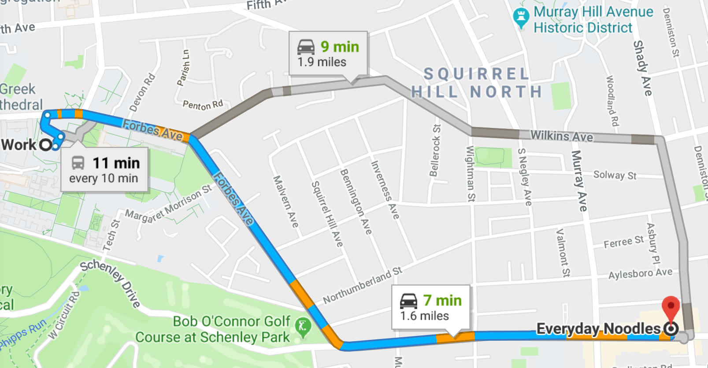
A* Applications
Pathing / routing problems
Resource planning problems
Robot motion planning
Language analysis
Video games
Machine translation
Speech recognition
…

Slide 46
Properties of A*

Slide 47
Properties of A*
Complete? Yes
  (unless there are infinitely many nodes with f ≤ f(G) )
Time? Exponential
  It depends on the quality of heuristic but is still exponential.
  with respect to the length of the solution
  better than other algorithms, but still problematic
Space? Keeps all nodes in memory
  O(b^{d}) space complexity,
  A* keeps all generated nodes in memory
  But an iterative deepening version is possible (IDA*).
Optimal? Yes
  A* is optimal if heuristic h is admissible (optimal).
Notes:
Also optimally efficient: any search based on h must expand as many nodes as A*. Reason: think of f(n) as saying: this path could lead to the goal as quickly as f(n). So must try it.

Slide 48
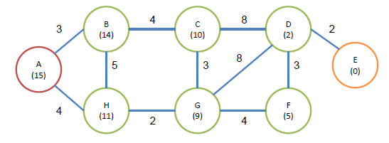
Activity
Perform Uniform Cost Search, the Best-First Search, and the A* algorithm. Here we suppose that A is the initial node, and E is the target. The cost of each edge and the heuristic value of the each node are also given in the figure.

Slide 49
Iterative deepening A* (IDA*)
Iterative deepening A* (IDA*) is a graph traversal and path-finding method that can determine the shortest route in a weighted graph between a defined start node and any one of a group of goal nodes.

Slide 50
It is a kind of iterative deepening depth-first search that adopts the A* search algorithm’s idea of using a heuristic function to assess the remaining cost to reach the goal.
A memory-limited version of A* is called IDA*. It performs all operations that A* does and has optimal features for locating the shortest path, but it occupies less memory.

Slide 51
Difference between IDA* and ID-DFS
Iterative Deepening A Star uses a heuristic to choose which nodes to explore and at which depth to stop, as opposed to Iterative Deepening DFS, which utilizes simple depth to determine when to end the current iteration and continue with a higher depth.

Slide 52
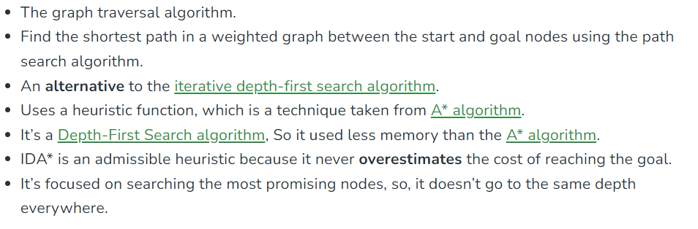
Key points

Slide 53
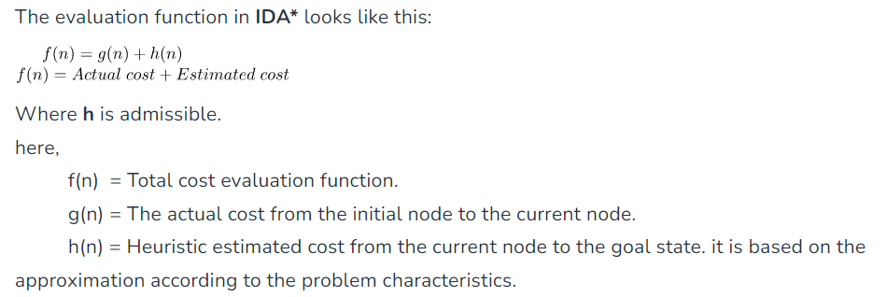
Evaluation Function

Slide 54
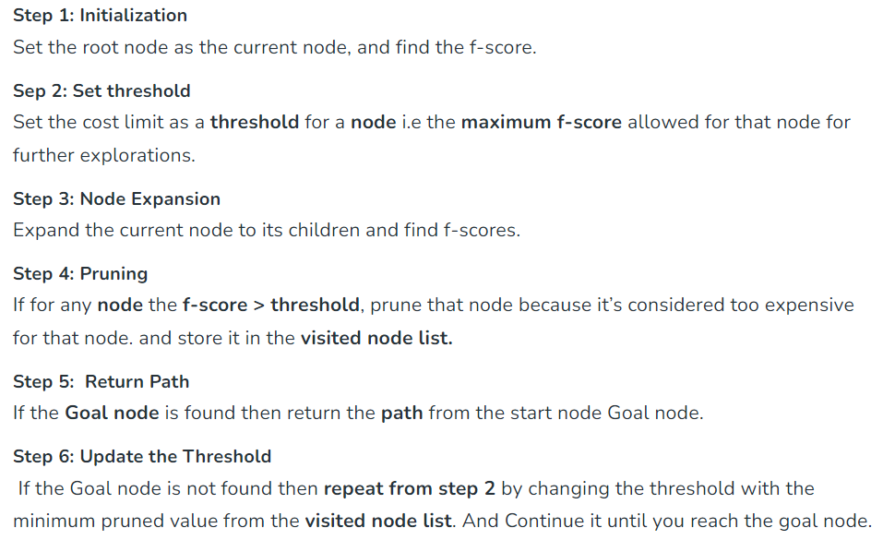




How IDA* works?

Slide 55
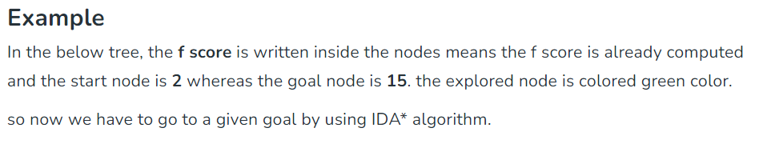

Slide 56
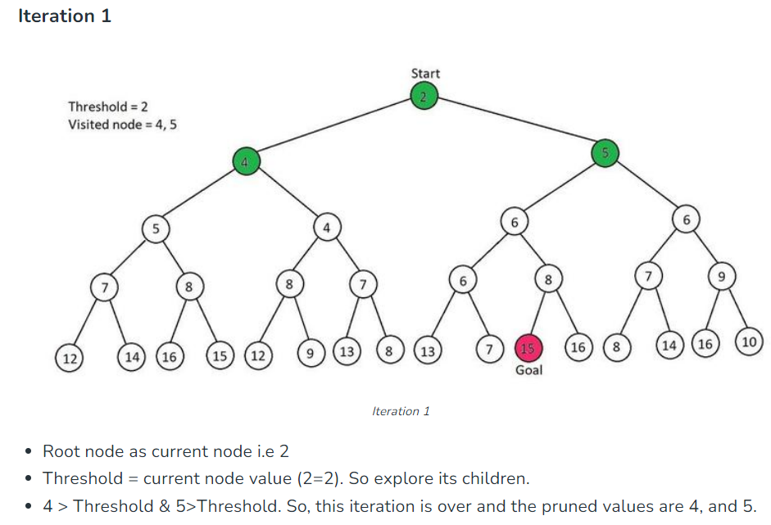


Slide 57
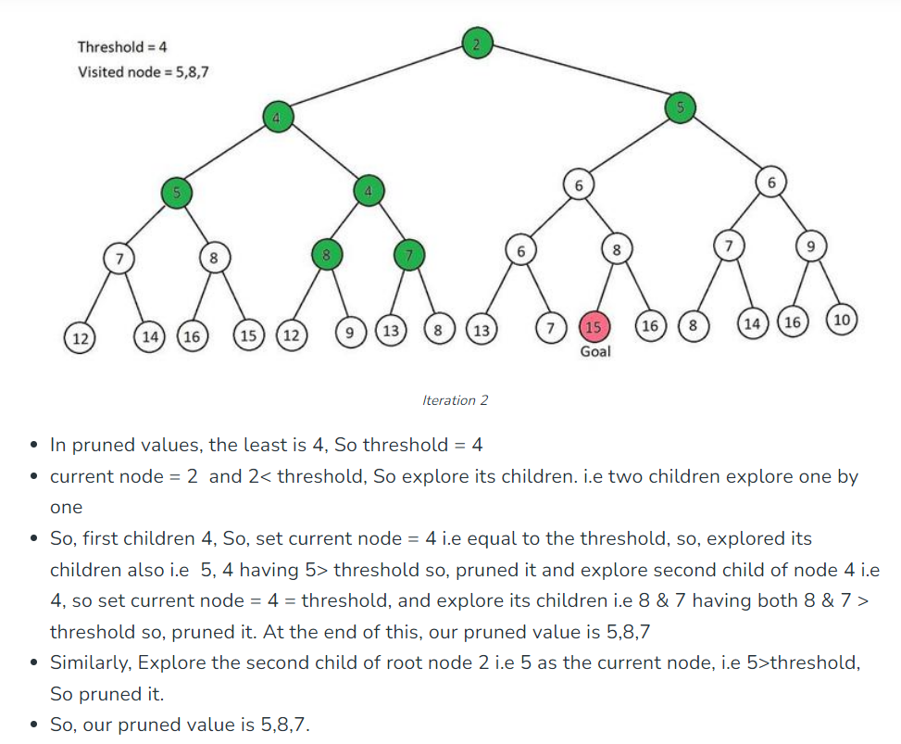
Iteration 2

Slide 58
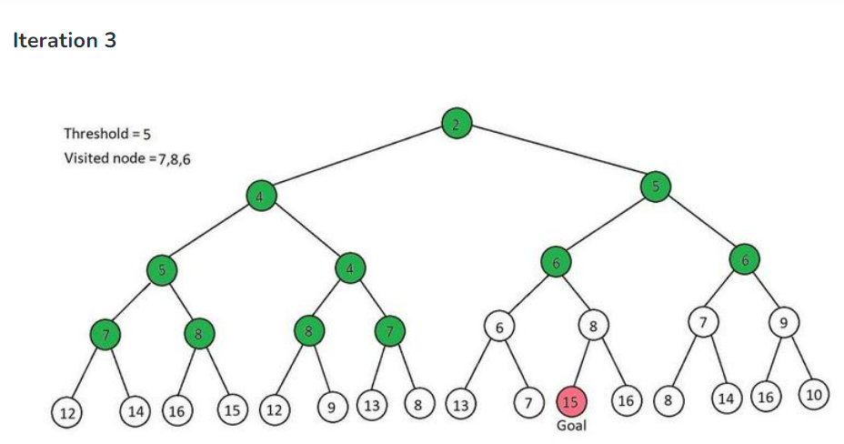
Pruned Values : 7,8,6

Slide 59
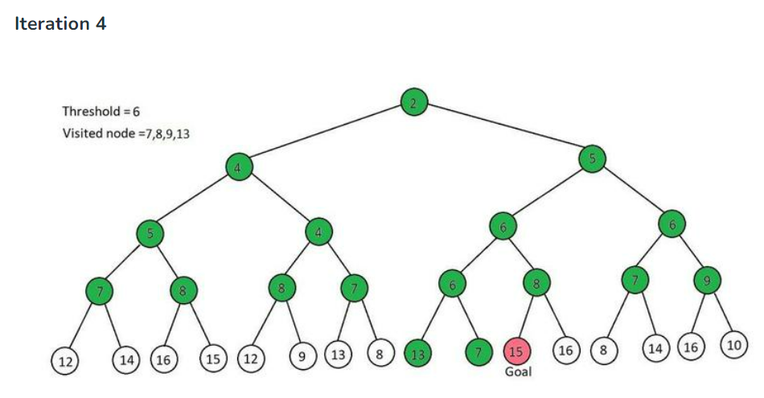
Pruned Values : 7,8,9,13

Slide 60
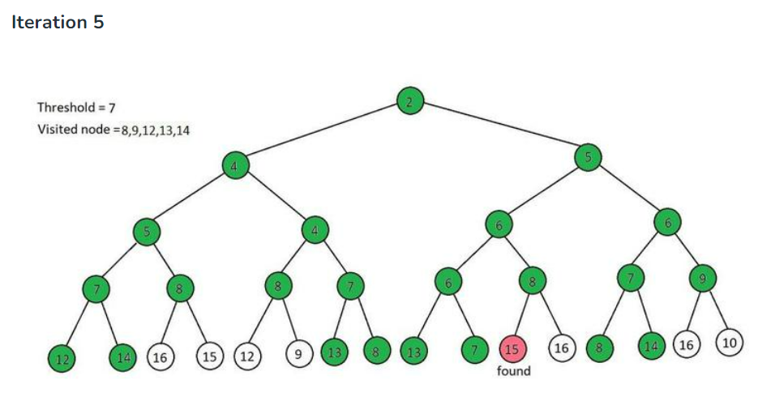
Pruned Values : 8,9,12,13,14

Slide 61
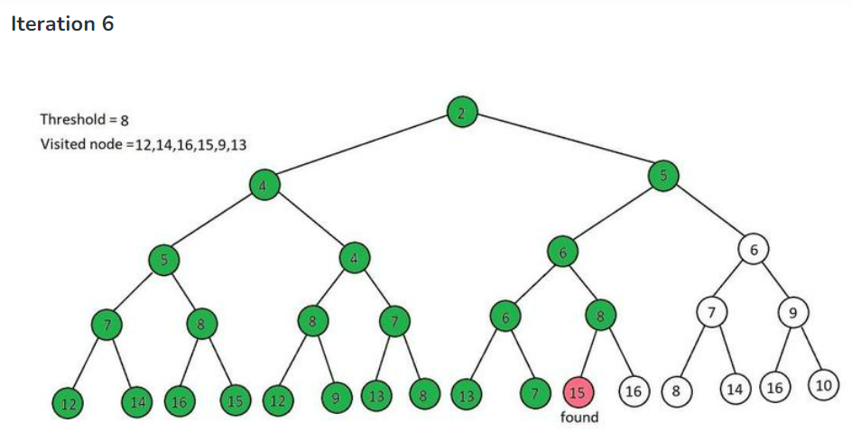
This will iterate till the threshold/ fscore does not reach 15

Slide 62
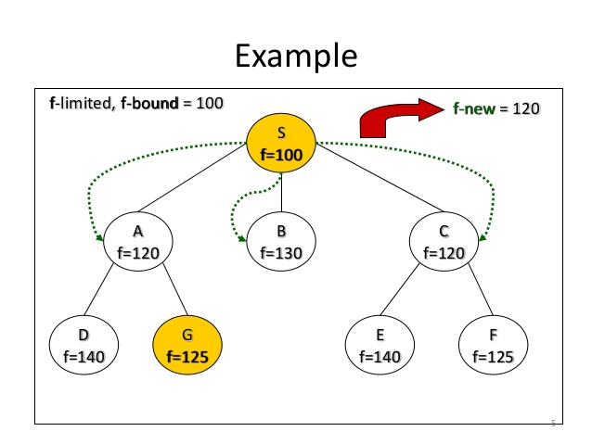



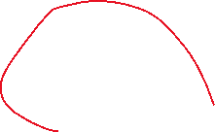

IDA*

Slide 63
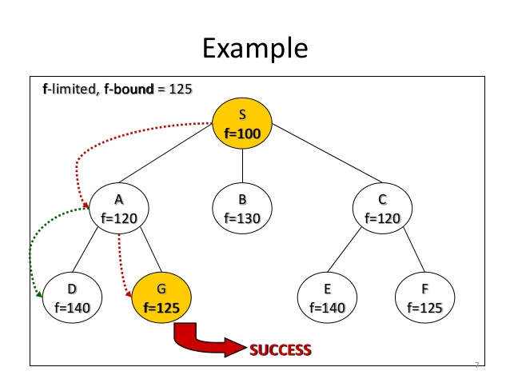
IDA*

Slide 64
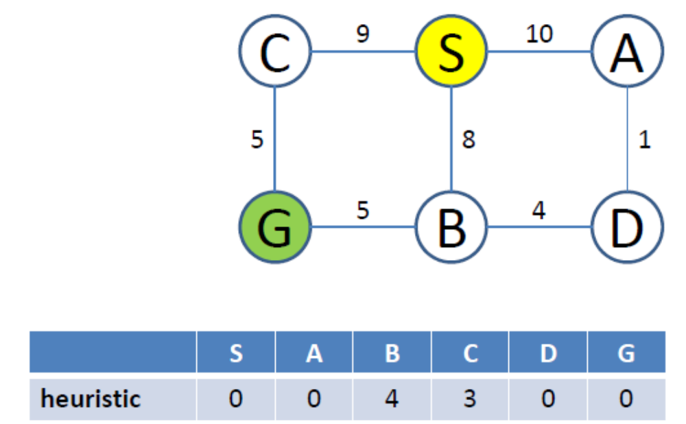

Slide 65
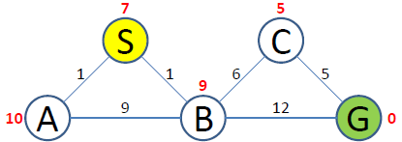
f_bound = 7
S(7)

Slide 66




f_bound = 7
f_new = 10
S(7)
A(11)
B(10)

Slide 67







f_bound = 10
f_new = 11
S(7)
A(11)
B(10)
A(20)
C(12)
G(13)

Slide 68



f_bound = 11
f_new = 12
S(7)
A(11)
B(10)
B(19)
C(12)
G(13)
A(20)

Slide 69








f_bound = 12
S(7)
A(11)
B(10)
B(19)
C(12)
G(13)
A(20)
G(12)

